Slide 1
A BPA Substitute
Safe, affordable, and clean
Sponsor: New Venture Development Organization: Umass Lowell

Slide 2
Introduction
Notes:
Shruti

Slide 3
Bisphenol A
Discovered in 1891 by Russian chemist Aleksandr Dianin
Used to harden polycarbonate plastics, invented in the 1950s
Very common in everything from cars to sales receipts
Most common, and dangerous, in plastic bottles

Slide 4
The Dark Side
Chromosome damage in female ovaries
Decreased sperm production in males
Early onset puberty
Various behavioral changes
Altered immune functions
Estrogenicity
Endocrine disruptor

Slide 5
Our Mission
To successfully market and sell our safe BPA replacement chemical
To have major beverage companies use our chemical instead of BPA
To dominate the plastic bottle market so drinking is safer for people of all ages
To eventually spread into other markets, such as baby products

Slide 6
Idea and Technology

Slide 7
BPA in general
It has been used to harden plastics for more than 40 years
It’s everywhere!
Medical devices, compact discs, dental sealants, water bottles, the lining of canned foods and drinks, and many other products.

Slide 8
What does it do to us?

Slide 9
BPA could potentially damage:
Brain
Behavior and prostate glands in fetuses
Infants
Young adults

Slide 10
BPA could damage environment
BPA is used in the production of epoxy resins, polycarbonate resins, and polyester resins.
It is water soluble.
It is also likely being released into the air as well.

Slide 11
Our solution!

Slide 12
Prof. Daniel Schmidt
at UMass Lowell has successfully:
Alternative epoxy resins
Demonstrated a compound that can form a network with similar properties to the equivalent BPA‐based material
No structural similarity to estrogen

Slide 13
So what are we trying to
achieve?

Slide 14
plastic bottles that will not cause any health effect to human body
our substance does not contain polycarbonate
cost the same!

Slide 15
MARKET SURVEY

Slide 16
OUR FOCUS

Slide 17
It is estimated that companies such as these spend between $700-$1400 per ton

Slide 18
SURVEY
~50 Billion plastic bottles were made last year.
~8 Billion pounds of BPA made last year.

Slide 20
BPA market
The BPA market is very large, accounting for $14.6 billion in sales in 2014.
8 Billion pounds of BPA is manufactured every year.
BPA free chemicals.
same price

Slide 21
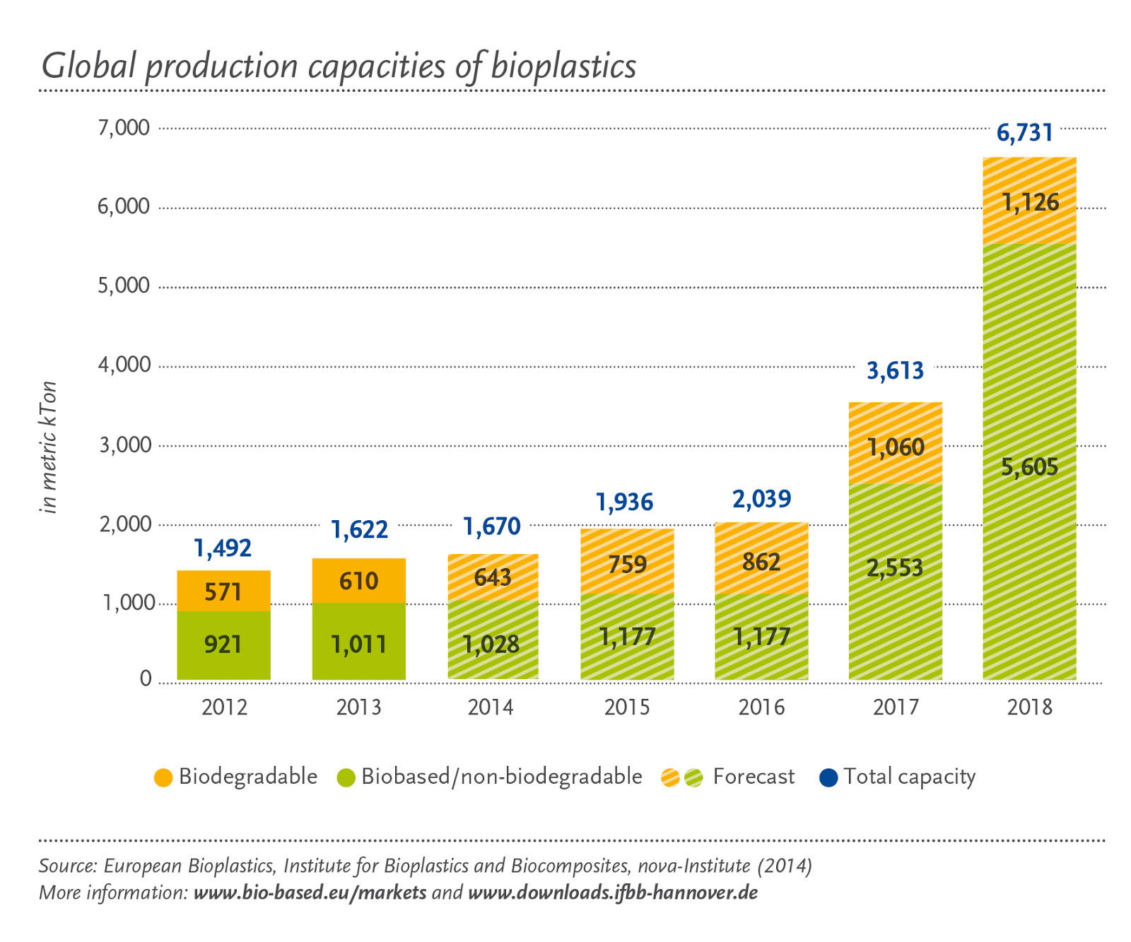

Slide 22
GROWTH RATE
The BPA market is very large, accounting for $14.6 billion in sales in 2014. 8 Billion pounds of BPA is manufactured every year.
The global BPA market is expected to grow by 5.2% annually, reaching $21.9 billion by the year 2022.
Expecting the rate of growth to be the same as that of BPA.
The Asia-Pacific area is the largest BPA market and accounts of for 54% of the global market.
The growth rate of North America and Europe is below the average growth rate, with 4.5% and 4.3%.
The attractiveness of the market is 5.5/7.

Slide 23
continued….

Slide 24
The growth rate of North America and Europe is below the average growth rate, with 4.5% and 4.3%.
The attractiveness of the market is 6.25/10.

Slide 25
CRITICAL SUCCESS FACTORS
Not harmful to human health.
Will increase competitiveness and attract new customers.
Our product is sustainable and eco-friendly.
Cost is same as that of BPA,hence affordable.

Slide 26
Factors | Weight | Rating | Score
Size of market | 0.1 | 4 | 0.4
Sales growth rate | 0.3 | 9 | 2.7
Competitor | 0.2 | 7 | 1.4
Industry's profitability | 0.2 | 6 | 1.2
Barriers to entry | 0.15 | 3 | 0.45
Regulations | 0.05 | 2 | 0.1
Total | 1 |  | 6.25

Slide 27
SPECIFIC STRATEGIES,PLANS AND ACTIONS

Slide 28
CUSTOMER RELATIONSHIPS
Global market
Develop and maintain
Sustainable and long-term customer relationships

Slide 29
CUSTOMER RELATIONSHIPS
Promote
Distribute
Track
Respond

Slide 30
DISTRIBUTION AND CHANNELS

Slide 31
Direct channel
Phone calls
Sales teams
Face-to-face negotiation

Slide 32
Indirect channel
Word of mouth
Advertisement
Online web sites

Slide 33
KEY PARTNERS
Plastic bottle manufacturers
Raw material suppliers
Investors

Slide 34
KEY ACTIVITIES

Slide 35
Manufacturing/Purchasing
Tests backup claims
Development
Marketing

Slide 36
KEY RESOURCES
Equipment, certification, human resources, prototype and training
Testing tools or standards
Mass media
Investors

Slide 37
Competition and Trends

Slide 38
An Ever-Growing Market
Formaldehyde and Phthalates
Bisphenol S
Bisphenol F

Slide 39
All are harmful to human health!

Slide 40
A Trending Topic
Discovered in the late 19th Century
Become popular with Polycarbonates in the mid 20th Century
Has become on of the most popular chemicals in the world
Sales rise as wind turbines become popular

Slide 41
Revenue

Slide 42
Cash is King
Asset sales will be our main source of revenue
Total polycarbonate market is $273.15 billion
Approximately 50 billion polycarbonate bottles made each year
We will target them, which includes Coca-Cola, Pepsico, and Nestle

Slide 43
Cost Structure
Costs of materials and supplies
Costs of energy, water, and fuel
Production worker wages

Slide 44
SWOT Analysis
Strengths
Non-toxic, eco-friendly, sustainable
Weaknesses
Many competitors, barriers to entry
Opportunities
Sales growth potential, public awareness of harmful chemicals
Threats
Competitors, projected growth of BPA

Slide 45
CONCLUSION

Slide 46
We have found that…
the current market for BPA (Bisphenol A) is growing consistently.
Implement a healthier BPA product.
Our future plan is to pursue in an additional application such as sports safety equipment manufacturers, automobile, and installation of wire.
BPA is the starting material for making polycarbonate plastics.

Slide 47
We’re targeting on dominating 80% of BPA market with our BPA substitution.
According to a survey 81 percent of Americans have detectable levels of BPS in their urine. And once it enters the body it can affect cells in ways that parallel BPA.
We’re targeting on dominating 80% of BPA market with our BPA substitution.

Slide 48
Work Cited
"The US Consumes 1500 Plastic Water Bottles Every Second, a Fact by Watershed." TreeHugger. Web. 10 Jan. 2016.
Vogel, Sarah. "The Politics of Plastics: The Making and Unmaking of Bisphenol A “Safety”." American Journal of Public Health. American Public Health Association. Web. 10 Jan. 2016.
"Toxicants in Food Packaging and Household Plastics." Google Books. Web. 10 Jan. 2016.
"Global Polycarbonate(PC) Resin Sales 2015 Market Research Report." Global Polycarbonate(PC) Resin Sales 2015 Market Research Report. Web. 10 Jan. 2016.
"National Institute of Environmental Health Sciences." Bisphenol A (BPA). Web. 10 Jan. 2016.
"High Purity Bisphenol F | Products and Solutions | Gun Ei Chemical Industry Co., Ltd." High Purity Bisphenol F | Products and Solutions | Gun Ei Chemical Industry Co., Ltd. Web. 10 Jan. 2016.

Slide 49
Q & A

Slide 50
Thank you!
Shruthi Kathare Shriya Desai XIA MIN (Summer)
Ryan Lally Krin Yongvongphaiboon

